Slide 1
Data Structures ICT-1211 Information and Communication Technology
Lecture-27
Date: //2024

Slide 2
TREES

Slide 3
Complete Binary Tree
The tree T is said to be complete if all it’s levels, except possibly the last, have the maximum number of possible nodes, and if all the nodes at the last level appear as far left as possible.
1
2 3
4 5 6 7
8 9 10 11 12 13 14 15
16 17 18 19 20 21 22 23 24 25 26

Slide 4
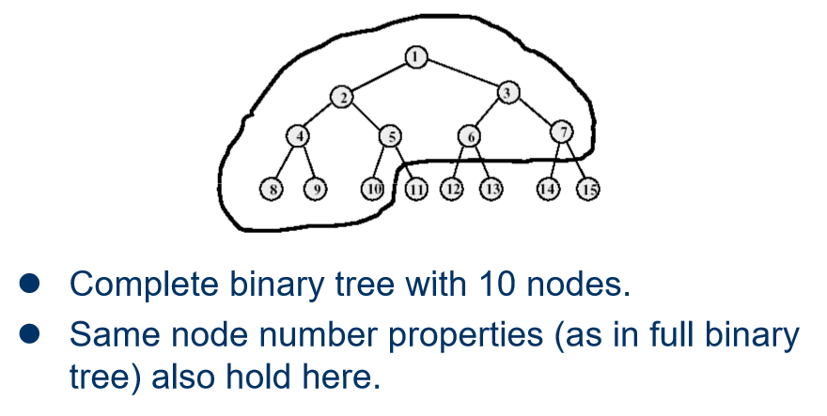
Example of Complete Binary Tree

Slide 5
Extended Binary Trees: 2-Trees
A binary tree T is said to be 2-tree or an extended binary tree if each node N has either 0 or 2 children. In such case, the nodes with 2 children are called internal nodes, and the nodes with 0 children are called external nodes.
Notes:
Circles-

Slide 6
Binary Tree Representation
Array representation
Linked representation

Slide 7
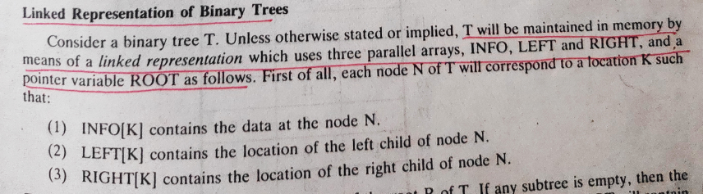
Binary Tree Representation
Linked representation
Furthermore ROOT will contain the location of the root R of T. If any subtree is empty, then the corresponding pointer will contain the null value; if the tree itself is empty, then ROOT will contain the null value.

Slide 8
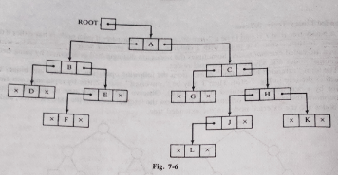
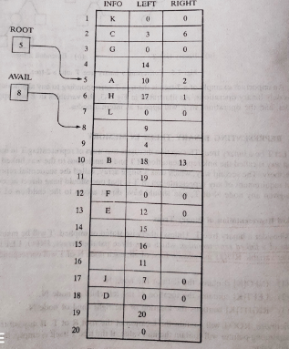
Binary Tree Representation

Slide 9
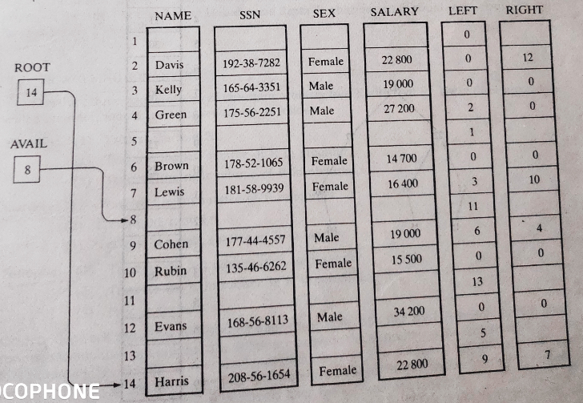
Binary Tree Representation

Slide 10
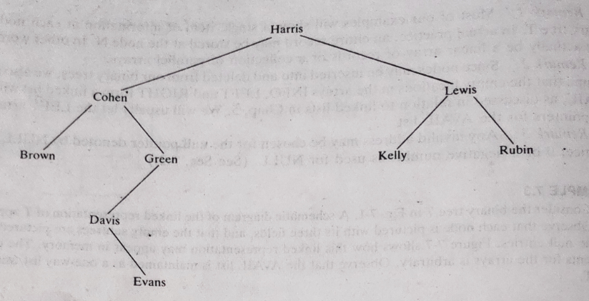
Binary Tree Representation

Slide 11
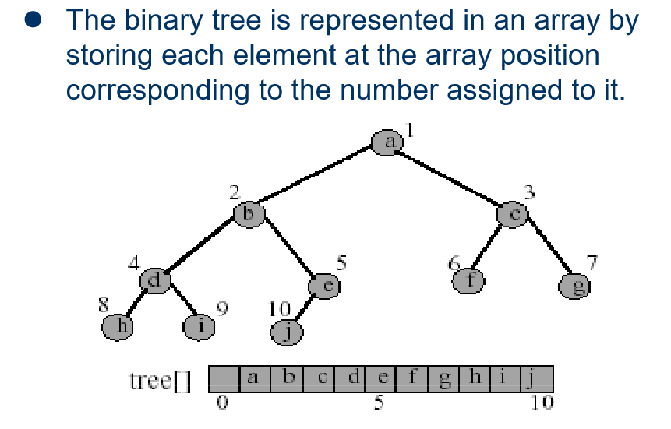
Array Representation of Binary Tree

Slide 12
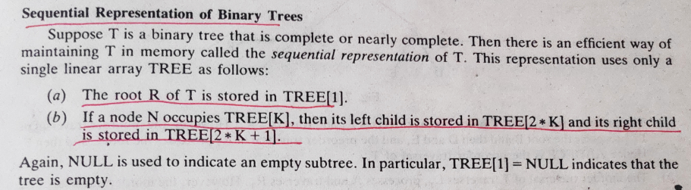
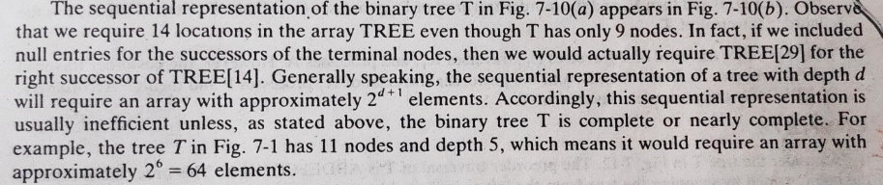
Array Representation of Binary Tree

Slide 13
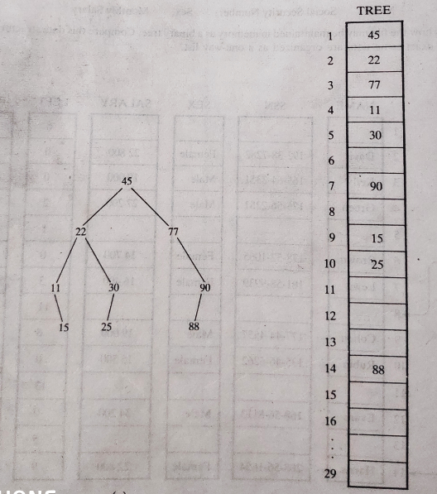
Binary Tree Representation

Slide 14
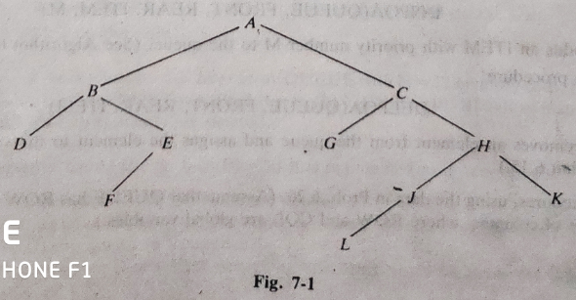
Binary Tree Representation

Slide 15
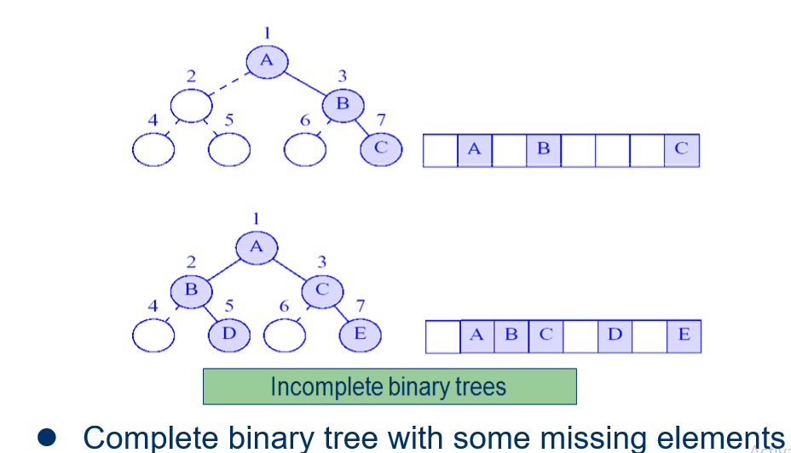
Incomplete Binary Tree

Slide 16
Traversing Binary Trees
There are 3 standard ways of traversing a binary tree T with root R. These three algorithms are called-
Pre-order traversal
In-order traversal
Post-order traversal

Slide 17
Traversing Binary Trees
Pre-order traversal:
Process the root R.
Traverse the left subtree of R in preorder.
Traverse the right subtree of R in preorder.

Slide 18
Traversing Binary Trees
In-order traversal:
Traverse the left subtree of R in inorder..
Process the root R.
Traverse the right subtree of R in inorder.

Slide 19
Traversing Binary Trees
Post-order traversal:
Traverse the left subtree of R in postorder.
Traverse the right subtree of R in postorder.
Process the root R.

Slide 20
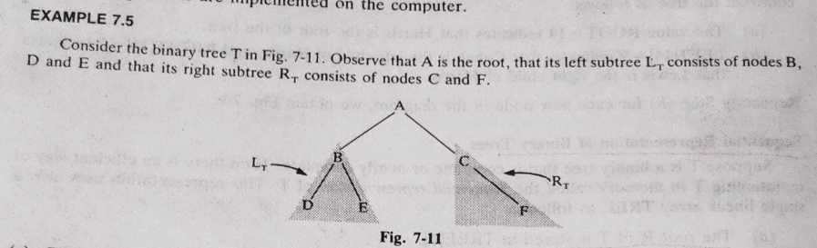
Traversing Binary Trees

Slide 21
Traversing Binary Trees

Slide 22
Traversing Binary Trees

Slide 23
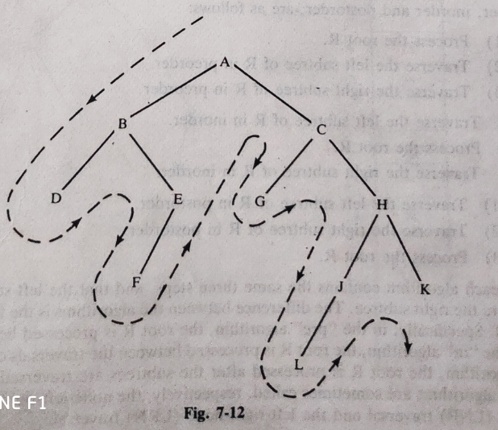
Traversing Binary Trees

Slide 24
Traversing Binary Trees
Pre-order traversal: ???

Slide 25
Traversing Binary Trees
Pre-order traversal:
A B D E F C G H J L K

Slide 26
Traversing Binary Trees
In-order traversal: ???

Slide 27
Traversing Binary Trees
In-order traversal:
D B F E A G C L J H K

Slide 28
Traversing Binary Trees
Post-order traversal: ???

Slide 29
Traversing Binary Trees
Post-order traversal:
D F E B G L J K H C A

Slide 30
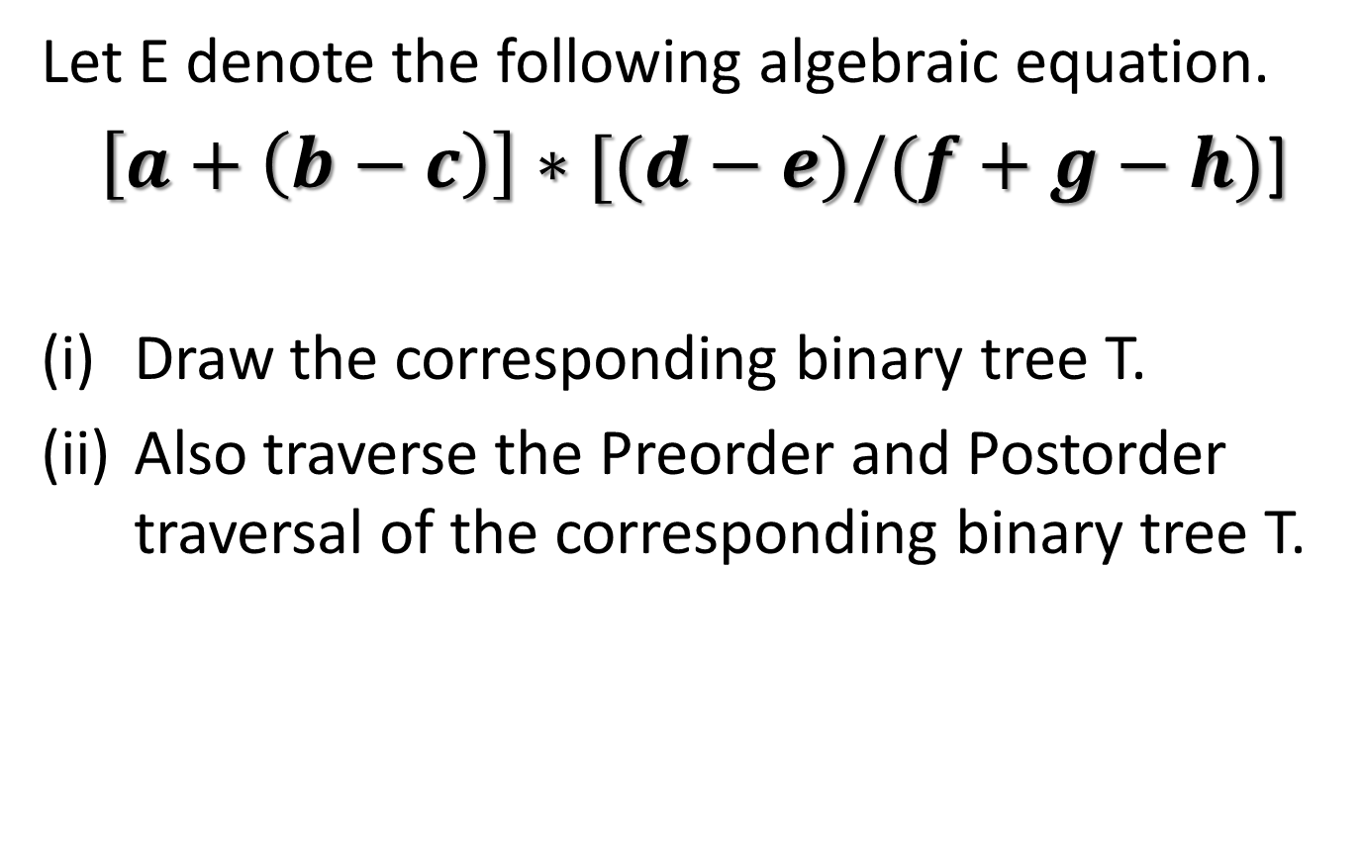
Traversing Binary Trees
Let E denote the following algebraic equation.
$\left[a+\left(b−c\right)\right]∗[(d−e)/(f+g−h)$]
Draw the corresponding binary tree T.
Also traverse the Preorder and Postorder traversal of the corresponding binary tree T.

Slide 31
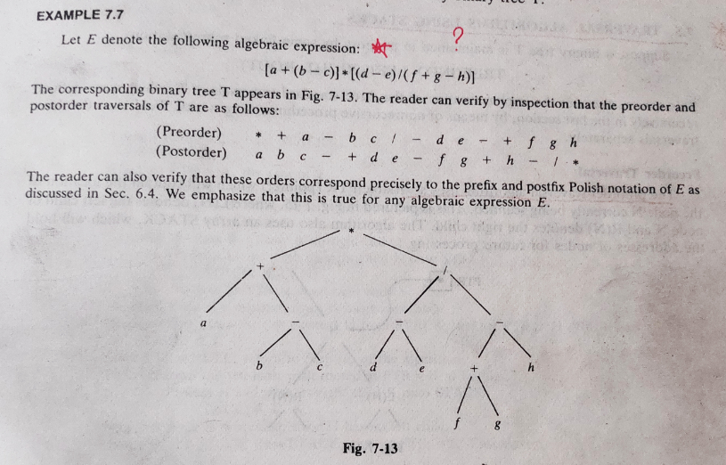
Traversing Binary Trees

Slide 32
Thank you……

